Slide 1
Moodle API V3 - Process Online Exam Marks
Session 84 – Johan van der Merwe

Slide 2
Overview
API v1.0 and v2.0
API v3.0 - Framework
Benefits
Lessons learned
Demo
Questions

Slide 3
API v1.0 and v2.0 Overview
API v1.0 – Data Take-on
Subjects
Lecturers
Students
Student Enrolments
API v2.0 – Create ITS Assessments
Create ITS Assessments Shells
Lecturer Assessments
Update ITS Assessments
Centralised Calculations

Slide 4
API Development
API v1.0
API v2.0
API V3.0
What’s next…

Slide 5
API v3.0 - Framework
Online Exams Special type of Assessment
Create Assessment Shells as per Exam Paper Criteria
Use Moodle’s Quiz Assessment Type
Update Marks as Exam Paper Marks
Update of Marks Centralised
Exam Mark Calculation based on Criteria

Slide 6
Benefits of using an API
Automated Take-on of Integrator Data
Link Defined Lecturers to Modules
Map Academic Structure to LMS
Students and Enrolments and Marks Synchronisation

Slide 7
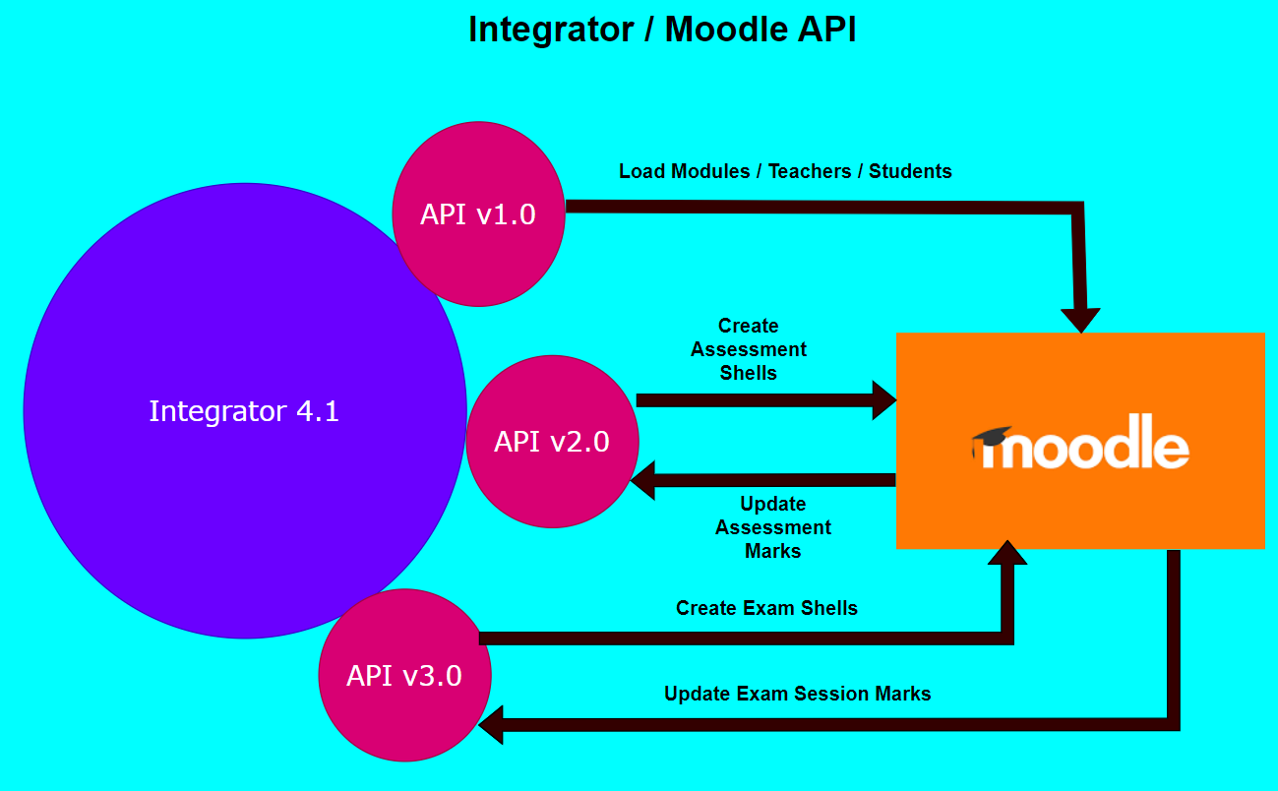

Slide 8
Lessons Learned
System Maintenance
  Backup / Clearing previous years data
  Copying of the Academic Structure
  Bulk loading of New Year’s Data
  Setup of Subject Criteria

Slide 9

Demo of the API v3.0 Process

